Slide 1
Network Mischief Managed: Automating perfSONAR Deployment, Management, and Measurement across a Global Campus
Duke University
Victor Orlikowski Jessica Repka
Notes:
Problem, value prop, what we did, problem
1

Slide 2
Value Proposition
Finding network congestion between your campus and points abroad
between your main campus and a remote campus
Finding network congestion on your internal networks
between the campus core and a building

Slide 3

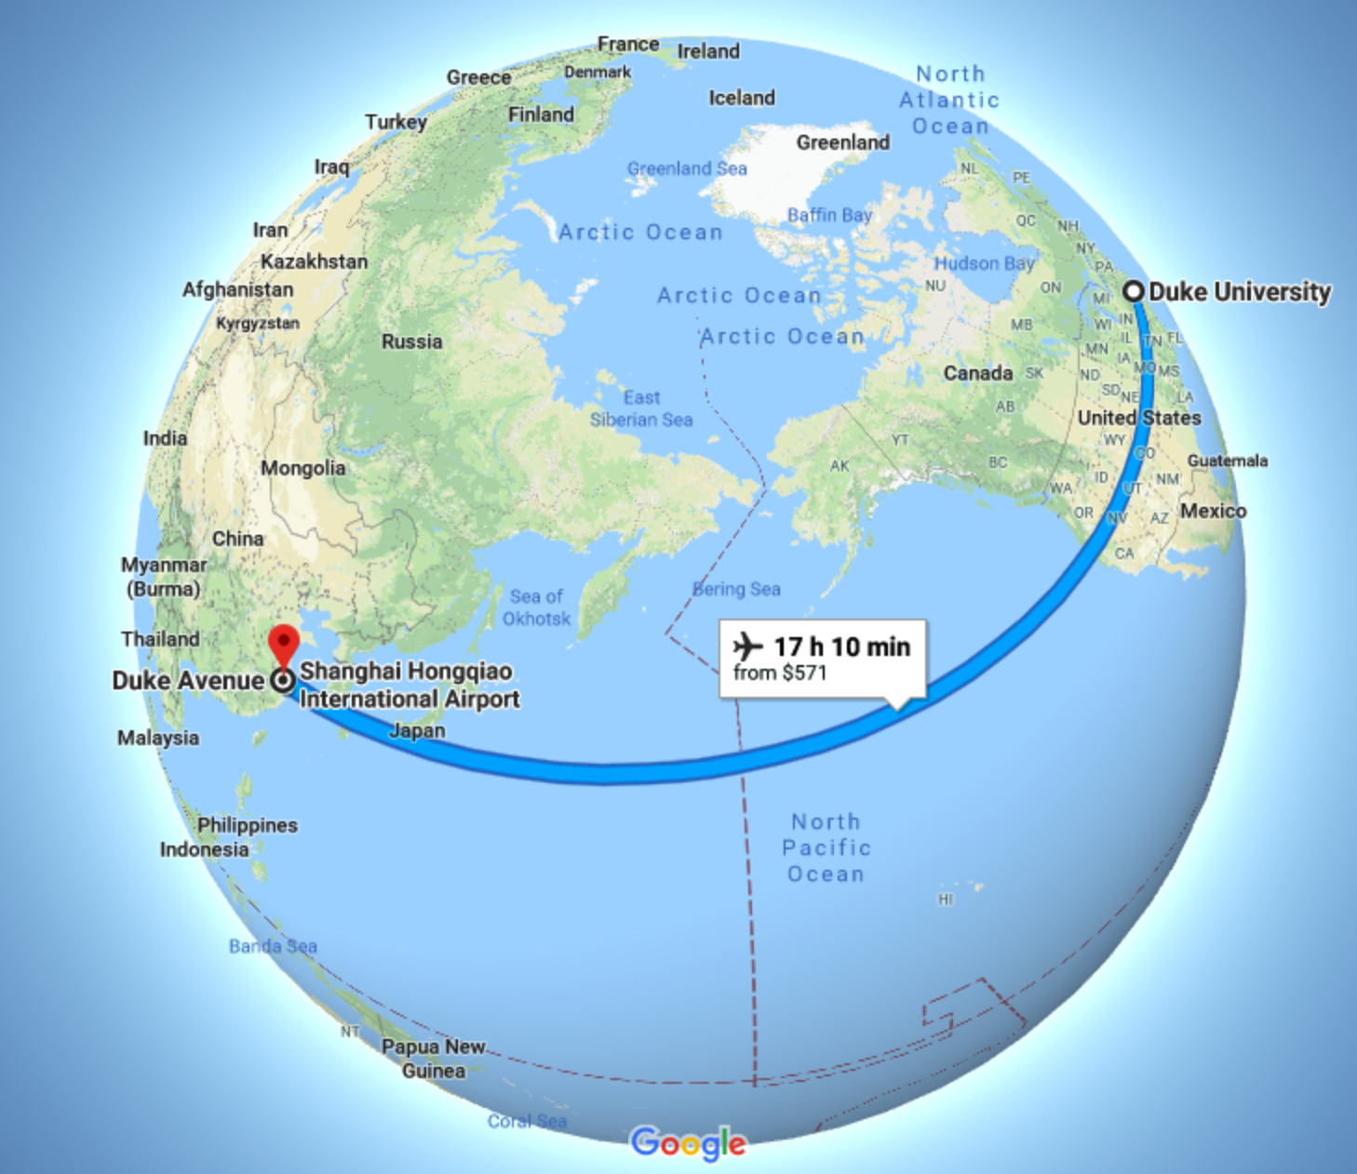

Hogwarts Express to China
Campus in Kunshan, China.
Faculty and students complained about slowness of transfers and services from Duke back to DKU.
Utilization graphs showed less traffic from Duke -> DKU compared to DKU -> Duke, which is not what we expected.
Was it Asymmetry?
Where’s routing breaking
Notes:
This was found in between our locations in the US and China proven by perfsonar on the throughput test. After checking to confirm it wasn't our equipment, we split our PerfSonar check into location-based checks.
We started to map from Kunshan and the US, Kushan and Shanghai, Kushan and LA.
This lead to a larger search eventually finding it to be the last mile of the connection which was a third part vendor.
PUT IN GEOGRAPHIC MAPS

Slide 4

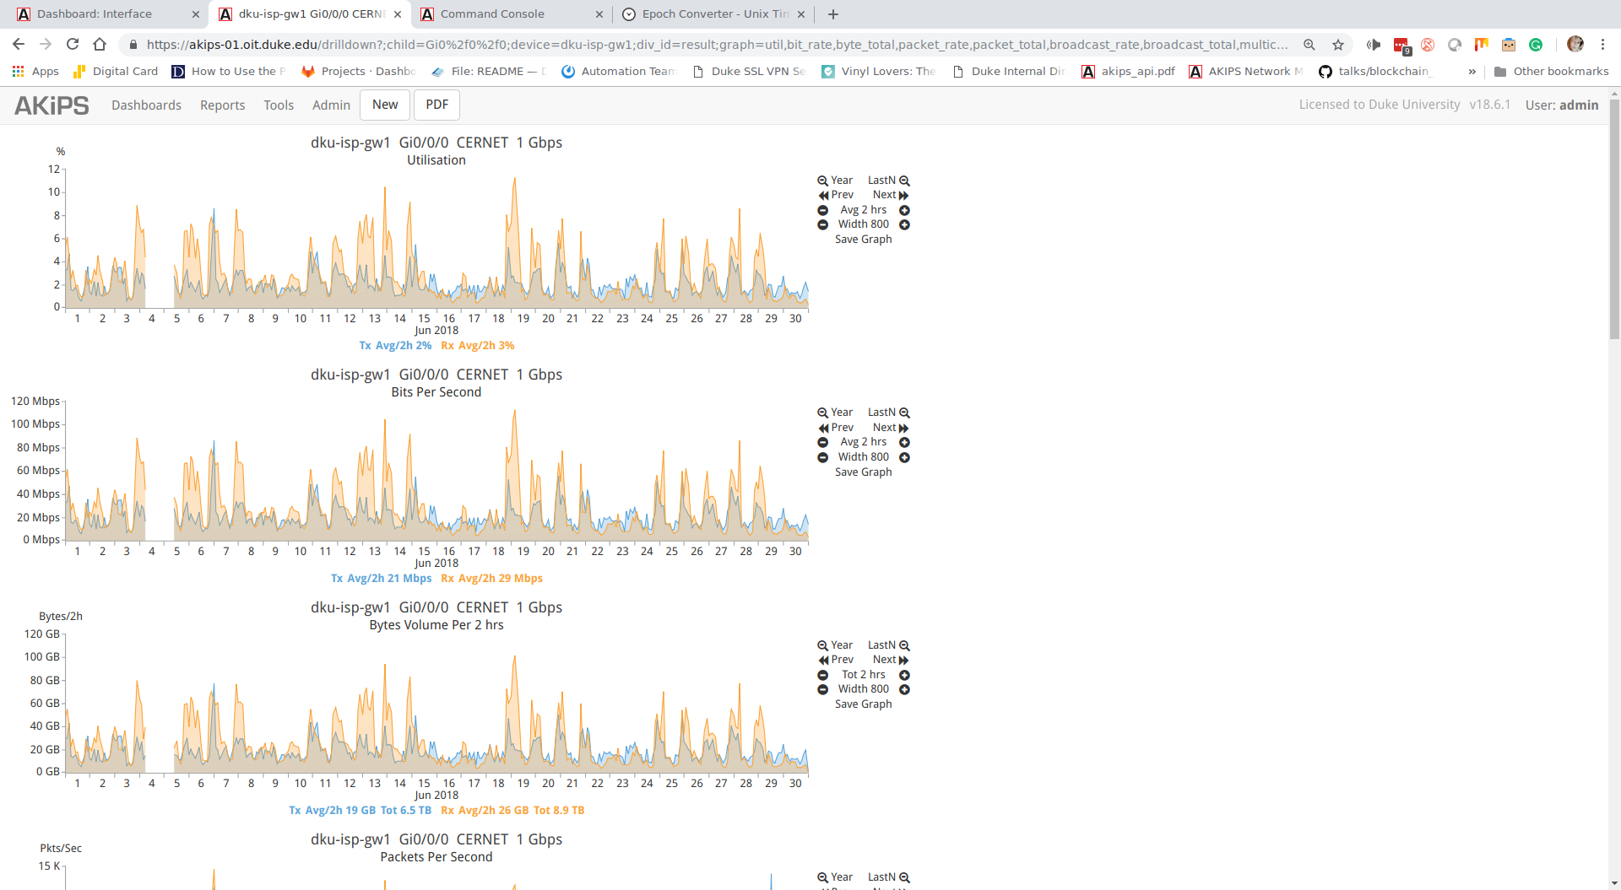
Is Owl Post Faster?
Access to storage at Duke was sluggish.
Deploying VMs from Duke to DKU could take up to a day or more
Sudden sporadic inability to access servers at Duke
Connection timeouts to websites or services
Normal utilization graphs were not enough; how could we identify where the network issues were occurring?

Slide 5
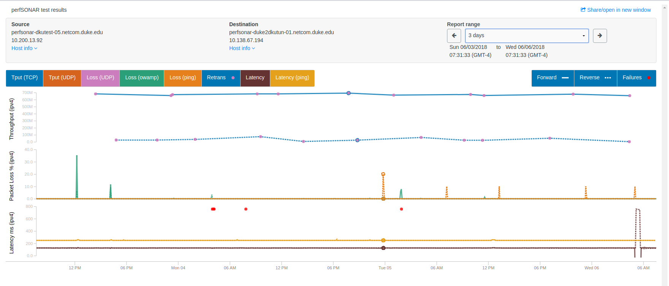


Accio Perfsonar!
DKU to Duke
Duke to DKU
Notes:
What are the functions of perfsonar that we found to be useful
Iperf3
Traceroute/ping
Oamp
5

Slide 6

Why is IT when something happens it's always you three? Initial Conclusions: People will think you're up to something
DKU (outside tunnel)
Beijing
I2
Duke (outside tunnel)
CERNET
LA
Shanghai
DKU (inside tunnel)
Duke (inside tunnel)
We inspected our devices, architecture and configs at both sites.
The audit uncovered a routing, but that did not solve the problem completely.
We measured from DKU to points along the path (Shanghai, LA, Duke), both forward and reverse.
The most noticeable difference was between Shanghai and campus.
This led to the realization that the last mile circuit needed to be investigated.

Slide 7
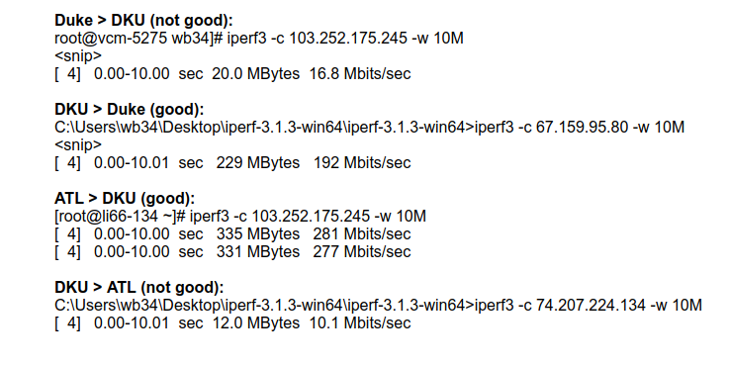

I Solemnly swear I'm up to no good
We moved one PerfSonar box outside the DKU firewall.
The issue remained, eliminating the firewall as the potential issue.
More testing: iperf3 from a Linux box in DKU to a VM in Atlanta
This test let us eliminate physical hardware issues; otherwise, the asymmetry would be consistent.
We also took into consideration rate limiting that CERNET has in place as part of this test.
One additional bit of information we had: any rate limiting should have been consistent - regardless of the IP addresses in use.

Slide 8
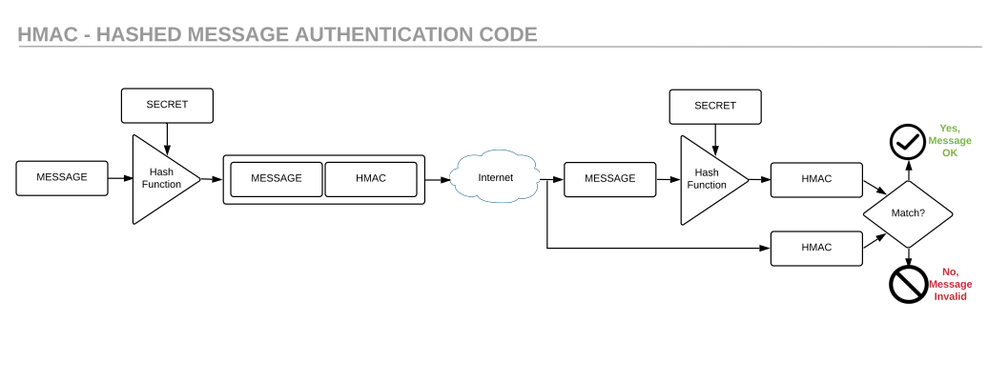


Another riddikulus problem Identified
HMAC Calculation mismatch: when the secret can't be matched from one side of the tunnel to the other.
We noticed an increase in IPSEC HMAC errors on traffic arriving at DKU from Duke starting to appear in the logs.
Software issue? According to our vendor no matching bugs had been logged…
The only time we had seen this previously was with in-transit traffic manipulation.
Notes:
The HMAC is generated by a calculation with a known secret on each side of the tunnel.
When sent the HMAC is included in the packet and encrypted message to be received on the opposite end.
Once received the calculation is generated again to confirm it is matching.
If the HMAC match fails, it is a sign to have been tampered with. If it matches the message is authenticated to move on.

Slide 9
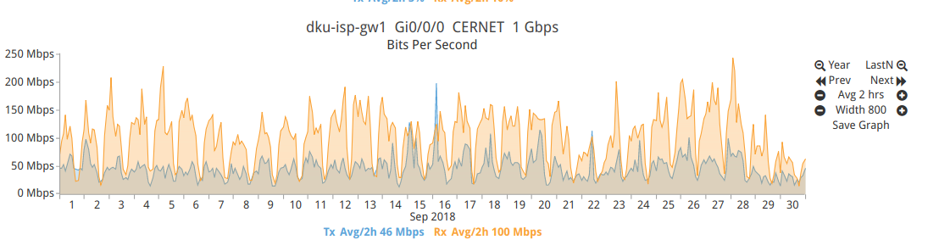
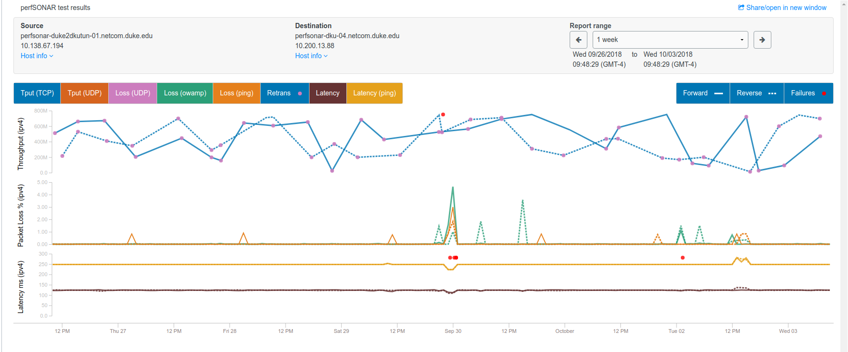
Things we lose have a way of coming back to us in the end.
Our ISP confirmed the issue also testing with PerfSonar.
This led to a new circuit being ordered and a pending deployment being put in place.
Our ISP has also deployed additional PerfSonar nodes for full testing across their network, with the intent of identifying asymmetric routing, routing changes, and congestion issues.

Slide 10
Perfsonar in the network (CorE <-> Building)
What if we could apply the same principles from the remote campus experiment?
Build a mesh network to identify asymmetric routing or congestion to key network services
Bldg
Core
PS (Bldg)
PerfSonar (Core)
Bldg
PS (Bldg)
Datacenter
Bldg
PerfSonar (DC)
PS (Bldg)

Slide 11

Automating PerfSonar
Original Installation: 2014
Physical Servers
“Hand-crafted, artisan” installation
Shibboleth login to control access
Had to touch each box to upgrade or change
Current: 2017 -2018
VMs
Relies on project-supplied installers/upgrades
No shibboleth login (backend login via LDAP)
Configs and Maddash stored on local VM
Future: 2018 -2019
Containerized deployments
Ansible configuration management
Post-config via Ansible
Controlled Pipeline CI/CD Environment
Deployed imaging service
Relies on project-supplied installers

Slide 12

Spell-O-TAPE ISN’t GOING to CUT IT…
perfSonar’s development model caused disruptions:
4.0 -> 4.1 update broke our MadDash; some changes seem arbitrary and appear to lack testing…
Development choices caused surprising issues (server-side generated JS cached by browsers indefinitely)
Hodgepodge of frameworks and languages (servlets, Django, perl) makes debugging issues…challenging.
IPv6 support, particularly with multiple interfaces, continues to cause us trouble.
Notes:
While working with perfSonar, we’ve run into several headaches.
For one thing – while perfSonar is marketed as being an “appliance” that can easily be deployed and allowed to automatically update, we found that the automatic upgrade from 4.0 to 4.1 broke almost all of our probe nodes. The issue? Constantly changing mesh configuration files. While 3.5 had an ”Apache”-style configuration, 4.0 moved to JSON. While 4.0 provided a tool to generate a JSON configuration from the old style configuration – 4.1 did an auto-migration from the 4.0 style of JSON to a new JSON representation, that no longer supported the “one-to-many” testing scheme (rather than a “full mesh”). Our meshes made use of this functionality – and having our entire mesh broken by not migrating all previously supported testing use cases does not comport with the advertised “appliance” deployment strategy.
This omission is but one of the few horrors in the code we’ve discovered, over our time using perfSonar. Amongst other examples, we also found: hard-coding of supported iperf3 versions in the code and dynamic generation of JavaScript by the MadDash server daemon - that gets cached to the browser with no expiration time specified (which led to some terrific confusion while attempting to debug MadDash issues).
Furthermore – the hodgepodge of languages and frameworks used in perfSonar means that, should anything go wrong, the deployer needs to be an expert in several different technologies to even begin at trying to figure out what’s going wrong; it feels as though there’s no top-level guidance or unity of design to the code. Some of this, we’re sure, is historical; nevertheless, it causes pain for anyone trying to make use of this otherwise excellent tool.
Finally – where we’ve tried to use perfSonar to monitor performance over IPv6 – we’ve run into some issues where monitoring has has been somewhat scattershot.
Overall – we’d recommend that the maintainers show more care in ensuring that features are not “accidentally” sunset. If they are being intentionally removed – it should over a longer duration (two releases), and with greater warning (i.e. the migration tools give clear warnings about features that are being deprecated). The unity of design issue seems to be slowly being addressed (to a degree) with the envelopment of more functionality into pscheduler - but more can certainly be done on that front. Finally – a stronger focus quality testing (especially with the betas and release candidates) for the code would be appreciated, particularly for the case of managing large deployments.

Slide 13

Questions?

